Slide 1
Data Science: Big Data Management Systems & Tools
Module 7: Spark Streaming

Slide 2
Module 7 Summary
Spark for processing streaming data
Learning Outcomes
Build more hands-on skills with Spark
Become familiar with Spark Streaming
Discover some of the newly-announced Spark and Databricks platform capabilities

Slide 3
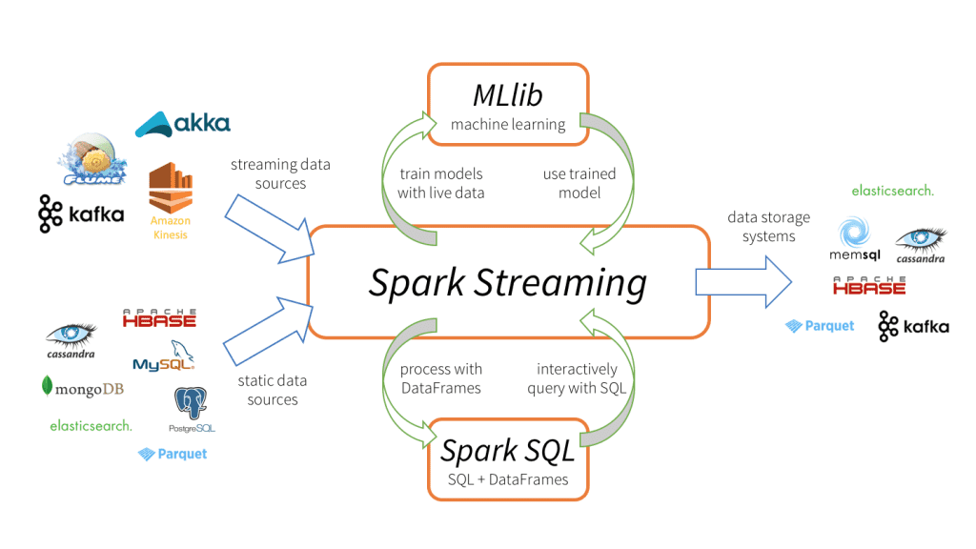
Spark Streaming
Four Major Benefits of Spark Streaming
Fast recovery from failures and stragglers
Better load balancing and resource usage
Combining of streaming data with static datasets and interactive queries
Native integration with advanced processing libraries (SQL, machine learning, graph processing)
Unification of disparate data processing capabilities is the key reason behind Spark Streaming’s rapid adoption. It makes it very easy for developers to use a single framework to satisfy a variety of processing needs.
Source: https://databricks.com/glossary/what-is-spark-streaming

Slide 4
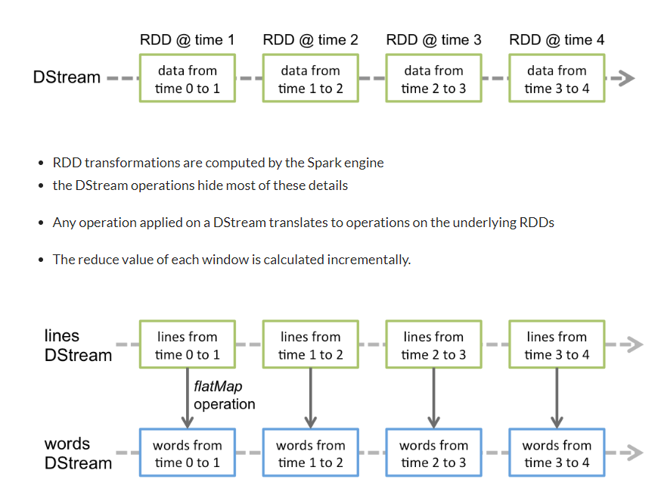
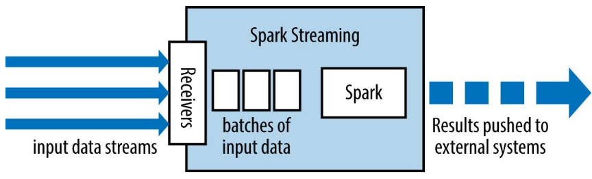
Spark Streaming Under the Hood
Source: https://www.analyticsvidhya.com/blog/2020/11/introduction-to-spark-streaming-add-new-tag/

Slide 5
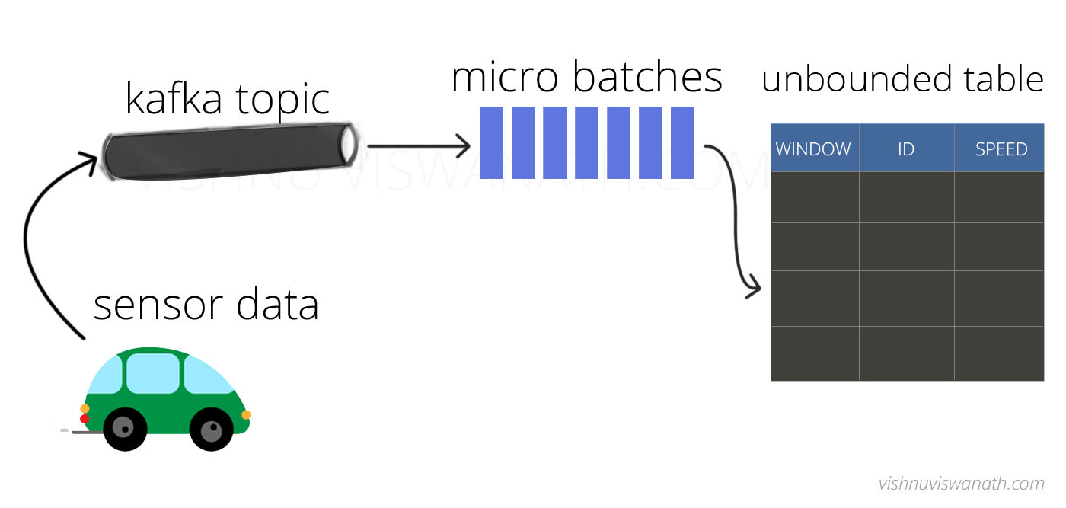
Structured Streaming Use Case
Imagine you started a ride hauling company and need to check if the vehicles are over-speeding.
We can create a simple near real-time streaming application to calculate the average speed of vehicles every few seconds
Source: http://vishnuviswanath.com/spark_structured_streaming.html

Slide 6
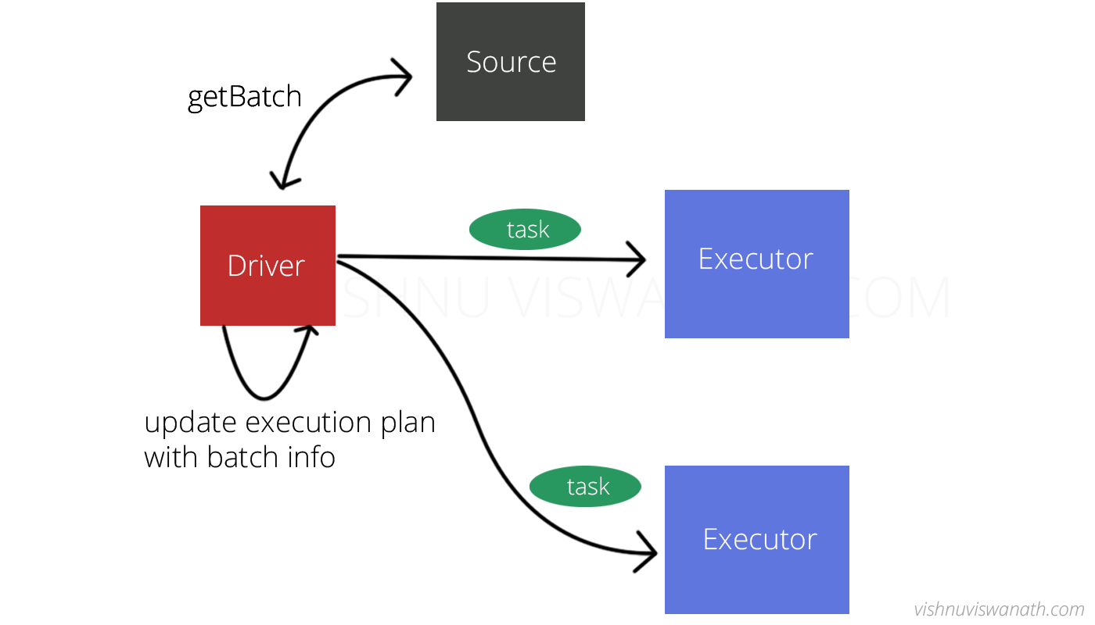
Spark Streaming Use Case
Uses micro-batching
Spark batches together events received during a small interval (e.g. 0-1 seconds)
The micro-batch is scheduled by the driver to be executed as tasks
Once micro-batch execution is complete, the next batch is scheduled
Scheduling is done frequently to give an impression of streaming execution
//a tumbling window of size 4 seconds
val aggregates = cars .groupBy(window($"timestamp","4 seconds"), $"carId")
.agg(avg("speed").alias("speed")) .where("speed > 70")
//a sliding window of size 4 seconds that slides every 2 seconds can be created using cars.groupBy(window($"timestamp","4 seconds","2 seconds"), $"carId")
Source: http://vishnuviswanath.com/spark_structured_streaming.html

Slide 7
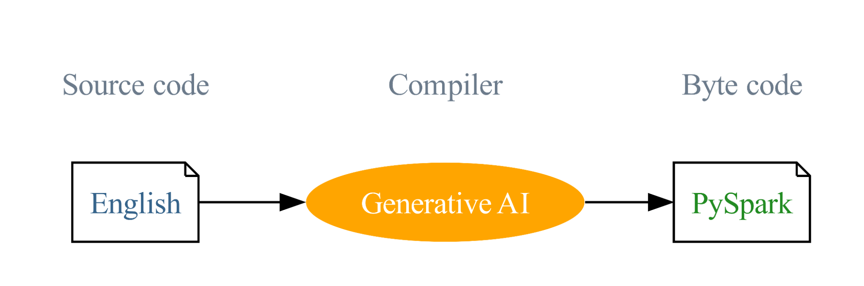
English SDK for Apache Spark
Similar to GitHub Copilot but generates PySpark and SQL
Can do web search to find most relevant examples
Understands Spark DataFrames
Source: https://www.databricks.com/blog/introducing-english-new-programming-language-apache-spark

Slide 8
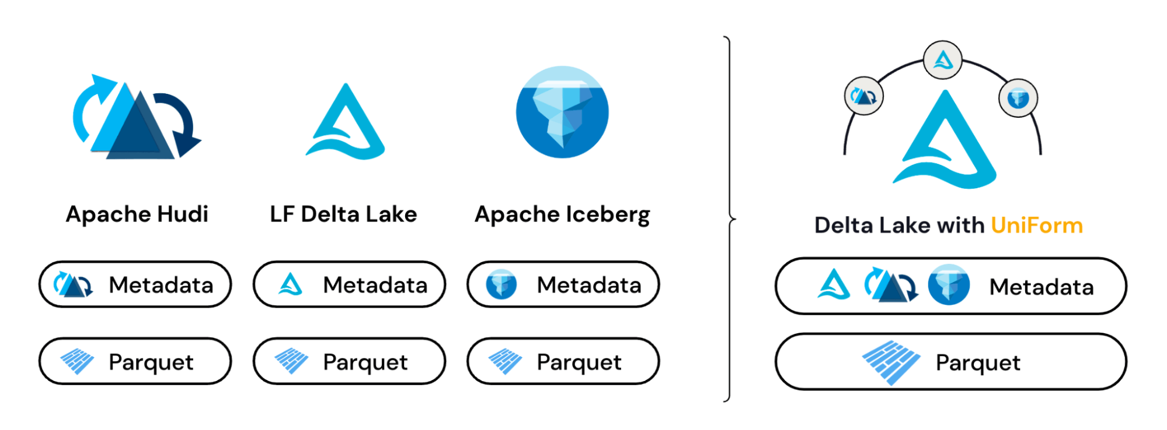
Delta Lake 3.0
Delta UniForm automatically translates Delta Lake to Apache Iceberg and Hudi
Source: https://www.databricks.com/blog/announcing-delta-lake-30-new-universal-format-and-liquid-clustering
Notes:
Also improved clustering.

Slide 9
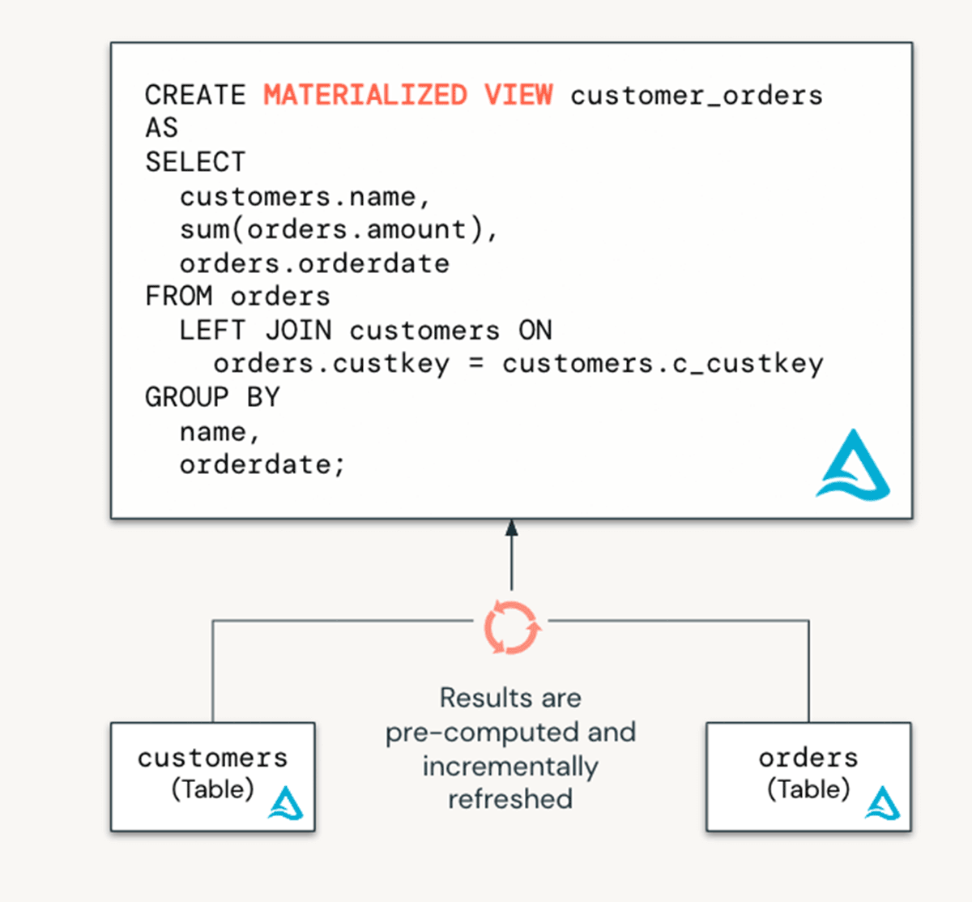
Materialized Views
Source: https://www.databricks.com/blog/introducing-materialized-views-and-streaming-tables-databricks-sql
Notes:
Whole raft of new LLM-powered features being developed within Databricks. Stay tuned.

Slide 10
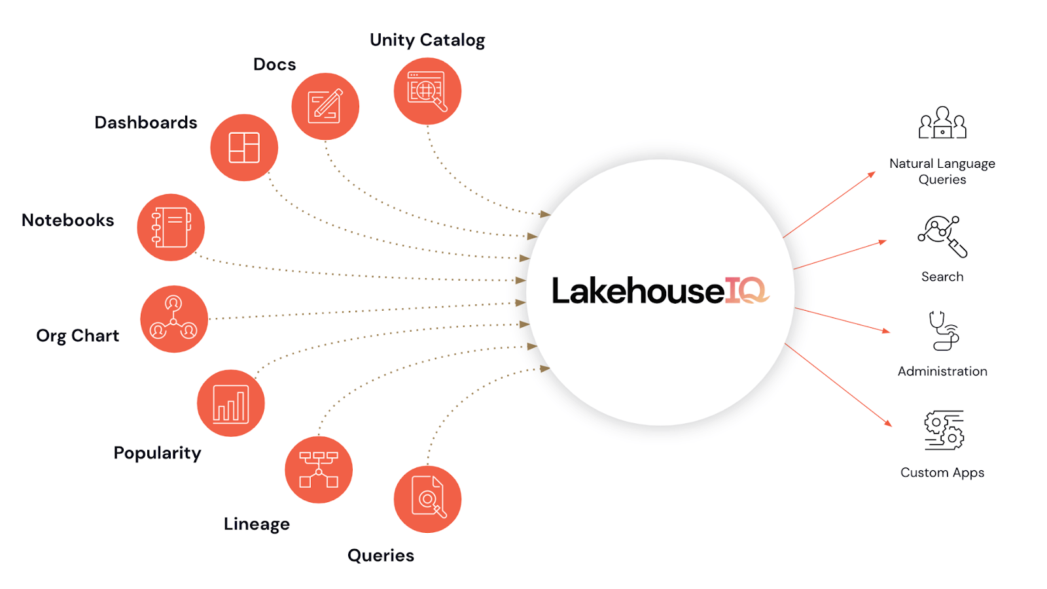
LakehouseIQ
LLM-powered assistants for search and management
Source: https://www.databricks.com/blog/introducing-lakehouseiq-ai-powered-engine-uniquely-understands-your-business

Slide 11
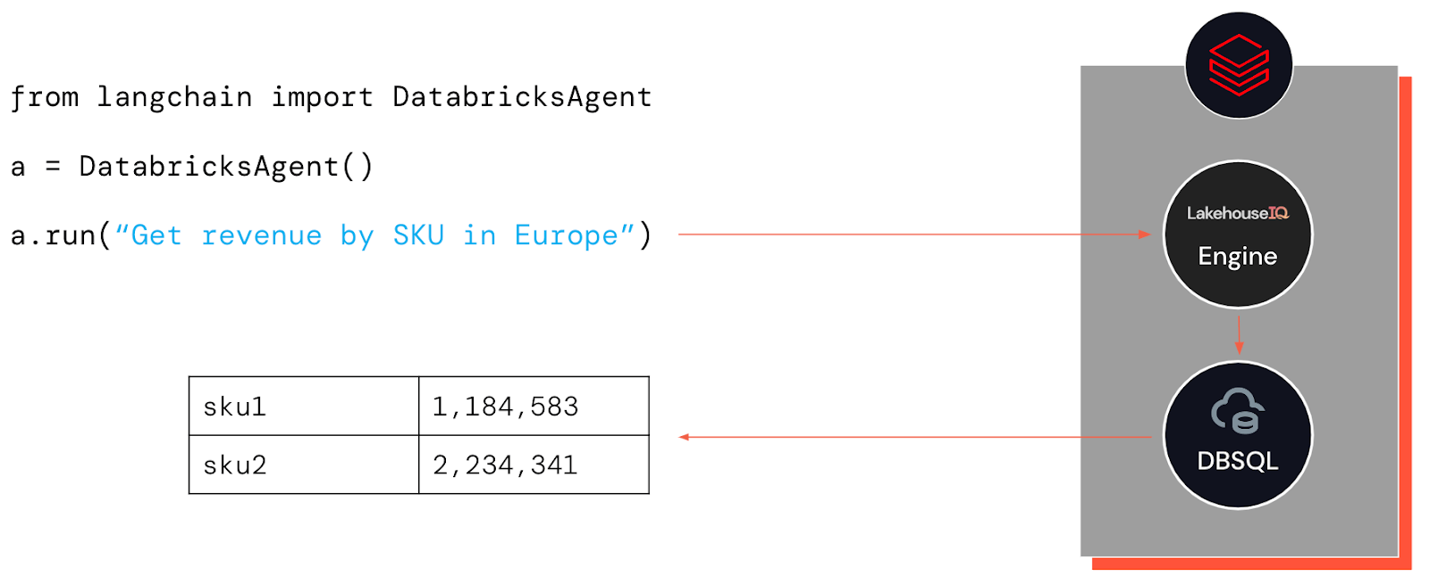
LakehouseIQ (cont’d)
LLM platform for business-specific intelligent querying and apps
Source: https://www.databricks.com/blog/introducing-lakehouseiq-ai-powered-engine-uniquely-understands-your-business
Notes:
Whole raft of new LLM-powered features being developed within Databricks. Stay tuned.

Slide 12
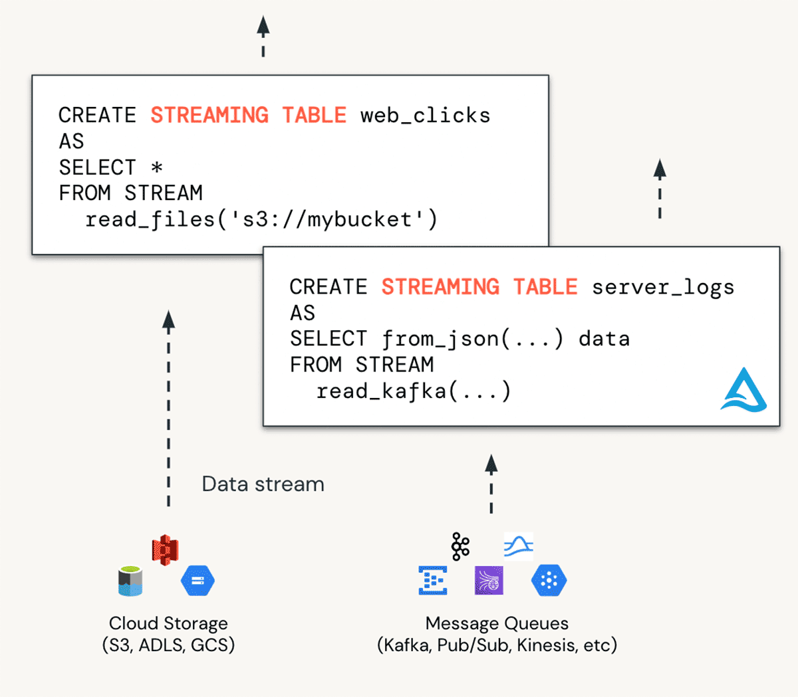
Streaming Tables
Source: https://www.databricks.com/blog/introducing-materialized-views-and-streaming-tables-databricks-sql
Notes:
Whole raft of new LLM-powered features being developed within Databricks. Stay tuned.

Slide 13
Lakehouse Apps and Databricks Marketplace
Lakehouse Apps capability allows building entire applications that run on the Databricks platform
Databricks Marketplace provides a way to sell data services to others on the platform

Slide 14
Volumes
Data Governance for unstructured data such as text, image, audio, video, PDF, or XML files
Also supports structured data
A new type of object that catalogs collections of directories and files in Unity Catalog
Provides all of the benefits of cloud-based storage but with tracking of data lineage

